Slide 1
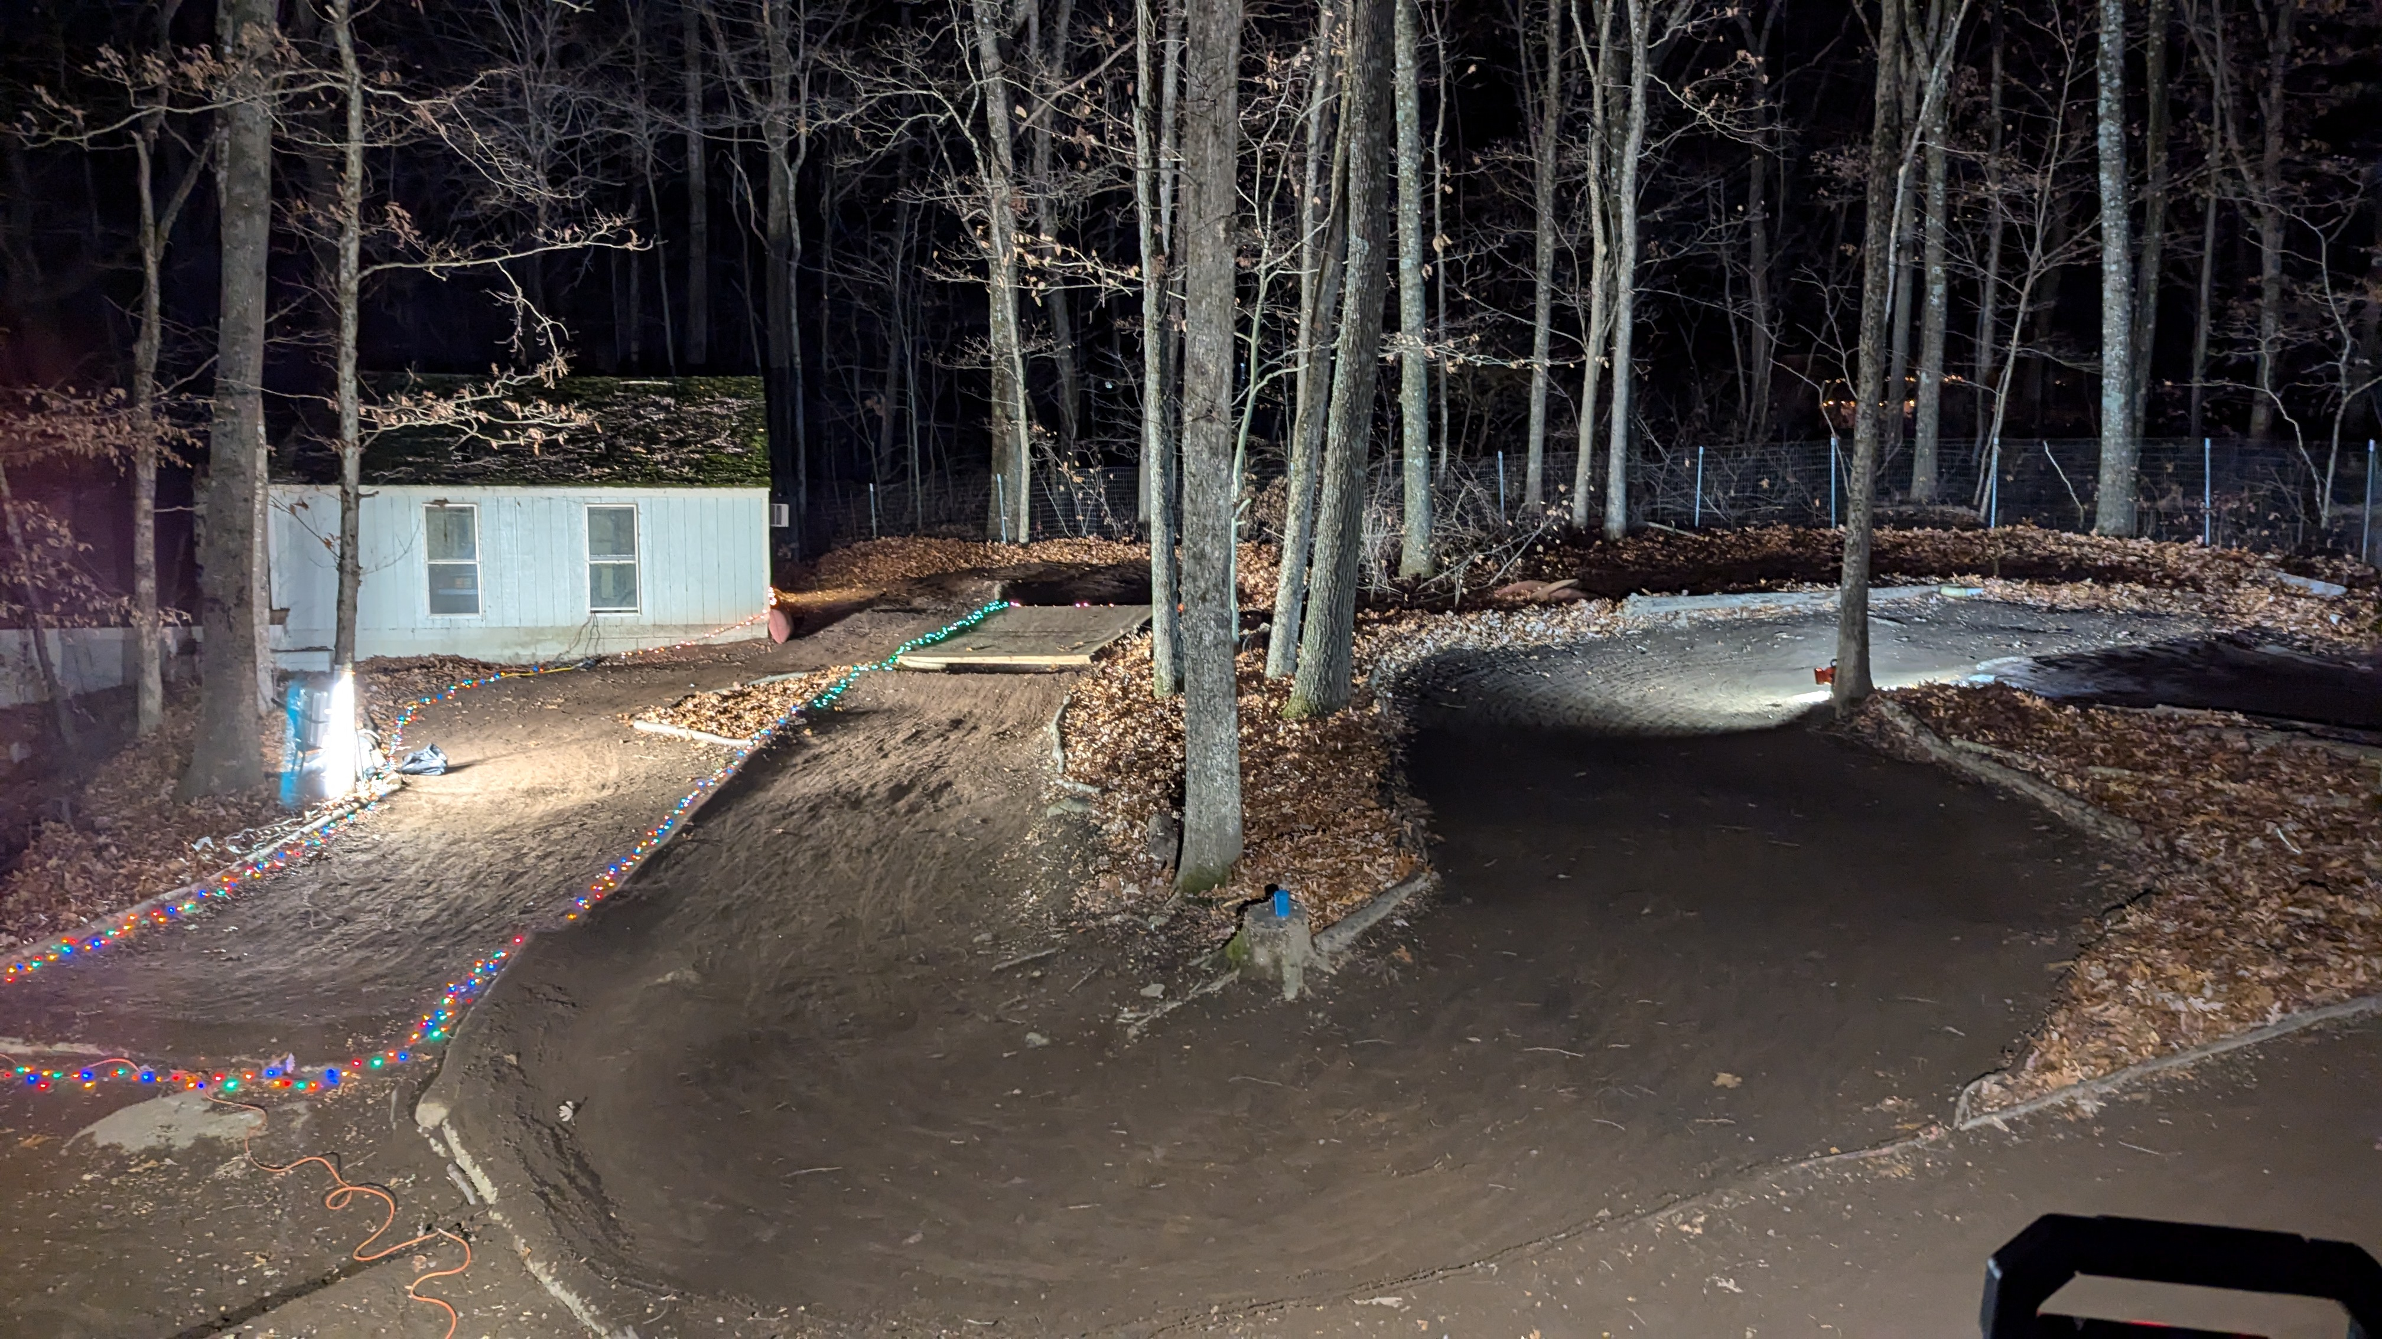
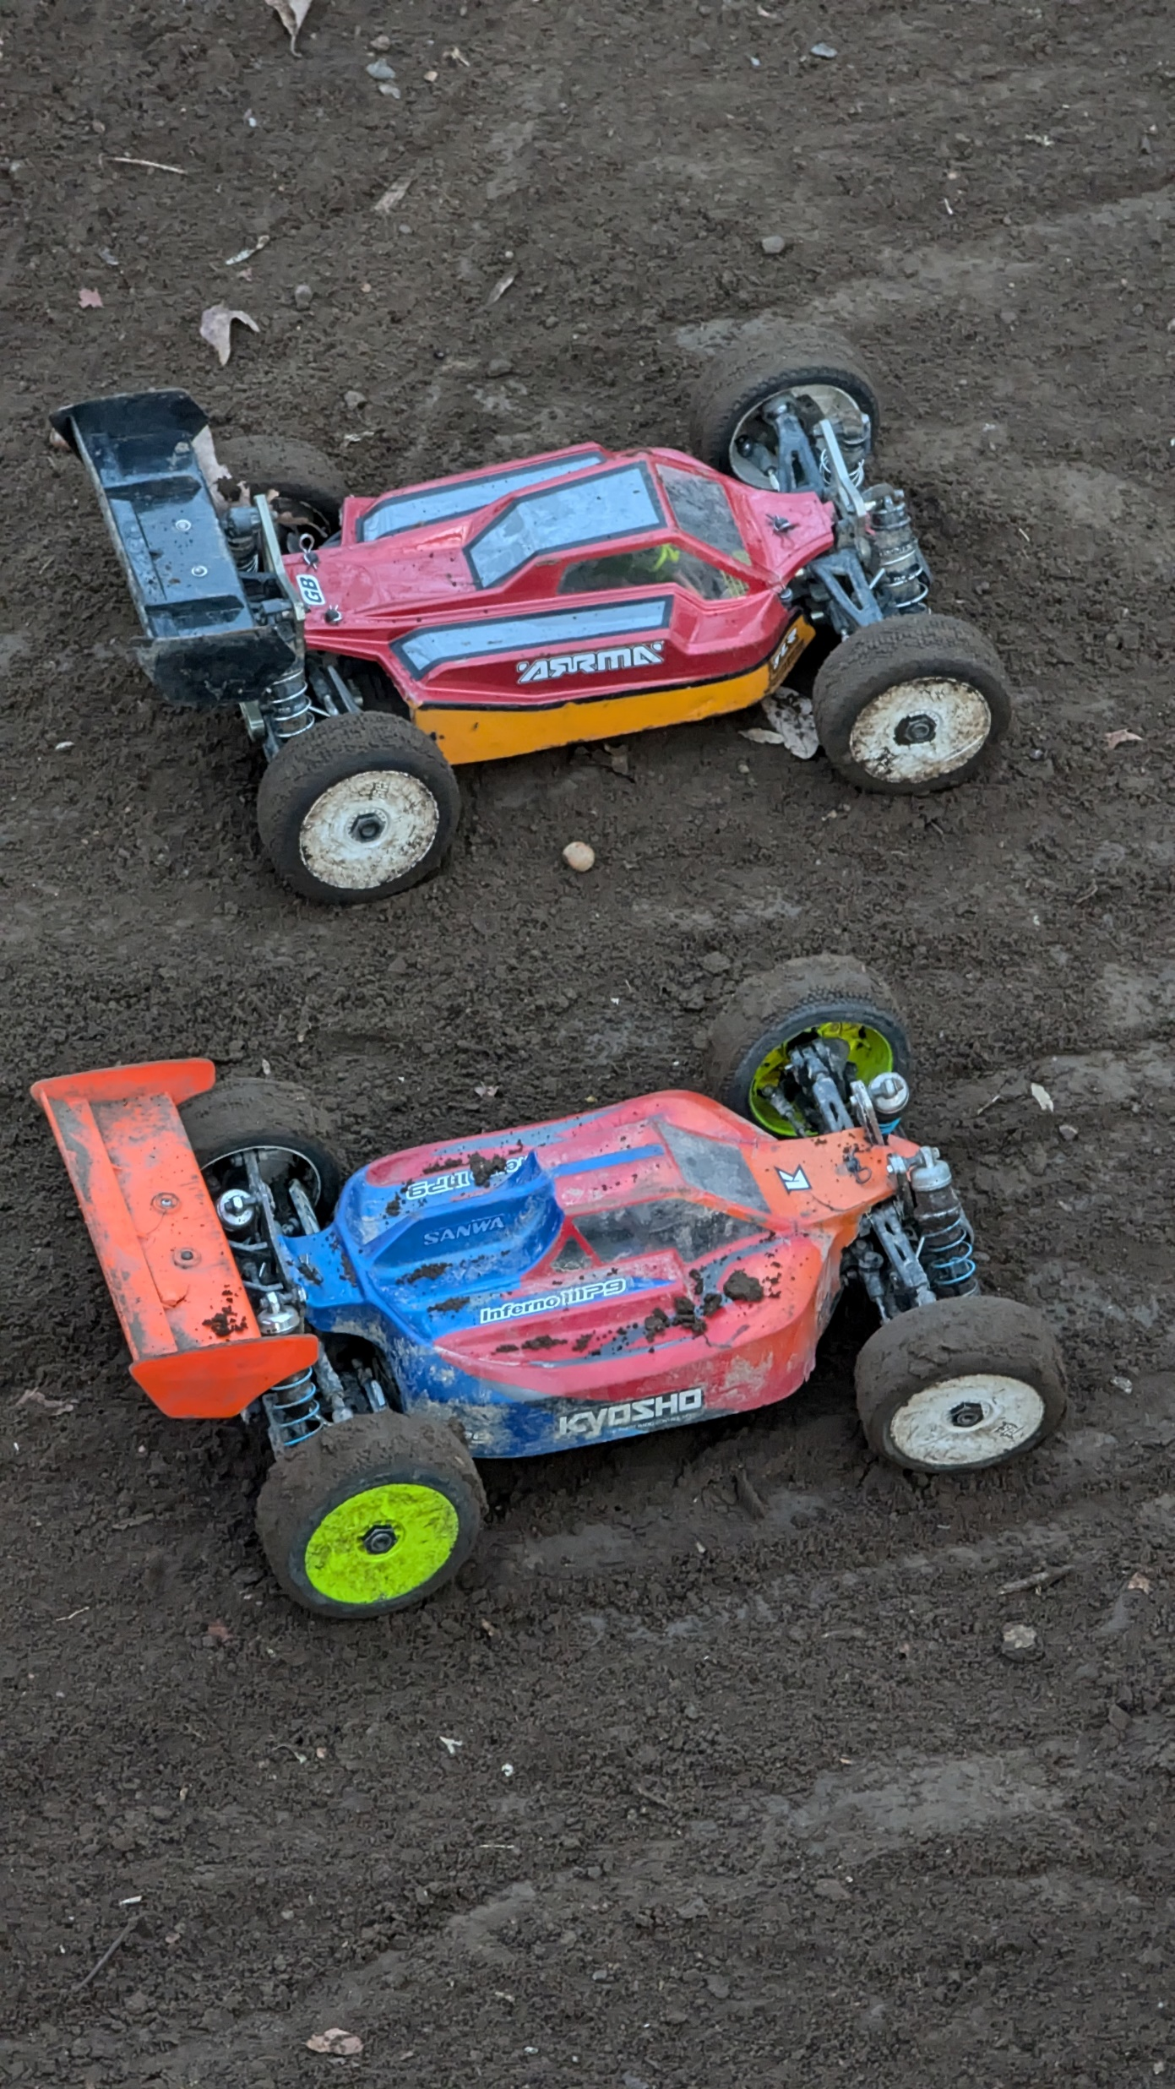
CISC-6100: Software Engineering
Design patterns, Security, Deployment
Week 13
December 2

Slide 2
Outline for today’s class
Homework: Design Patterns
Design Exercise (Continued)
Software maintenance
Security concerns
Design Exercise (Continued)
Wrap-up: Presentations, Final, Closing comments
Project time

Slide 3
Design Patterns

Slide 4
A design pattern is:
General, reusable approach to a commonly occurring problem
A description for how to solve a problem that can be used in many different situations
Formalized best practices to use for common problems
A design pattern is not:
A finished design that can be transformed directly into source code
Four general ways to group design patterns are:
Creational Patterns
Structural Patterns
Behavioral Patterns
Concurrency Patterns
However, there are many domain specific design patterns:
User interfaces
Information visualization
Secure design
Secure usability
Web design
Business model design

Slide 5
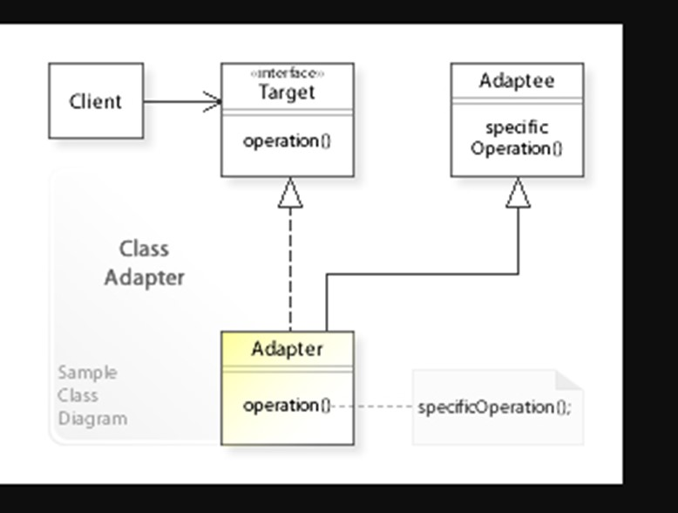
Selected Design Pattern Examples: Adapter
Allows the interface of an existing class to be used as (via) another interface. It is often used to make existing client code work with others without modifying their source code.
https://commons.wikimedia.org/wiki/File:W3sDesign_Adapter_Design_Pattern_UML.jpg#/media/File:W3sDesign_Adapter_Design_Pattern_UML.jpg

Slide 6

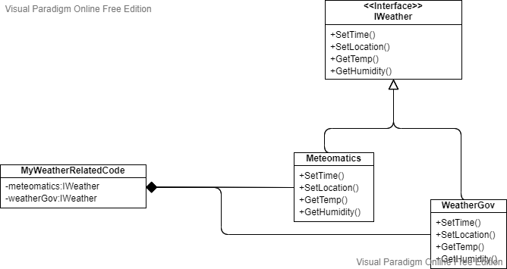
Interfaces
APIs
Meteomatics.com
target
adaptees
client
APIs
Weather.gov
adapters

Slide 7
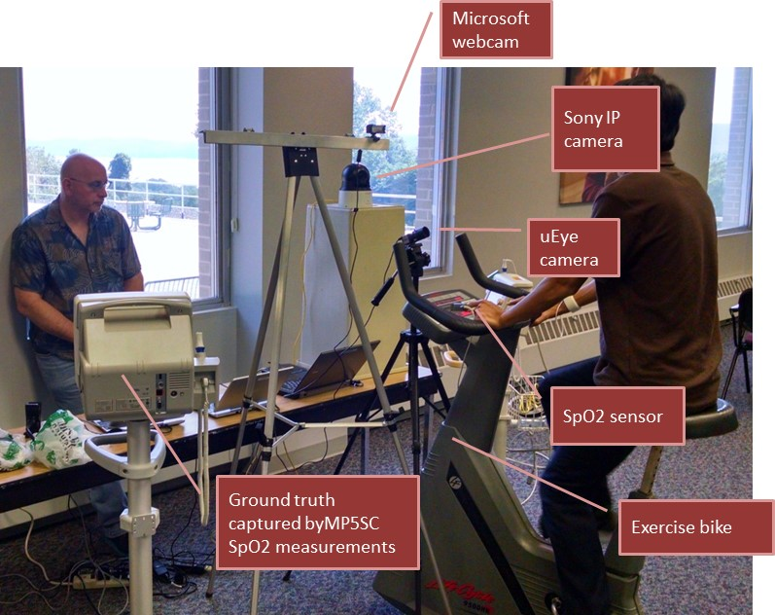
Selected Design Pattern Examples: Observer or Pub/Sub
In the observer or publish/subscribe pattern an object, called the subject, keeps track of a list of observers and notifies them upon state changes of interest.
Priority queue
Next patient
Patient not found
Complete
New patient
Discharged patient
Registration
New patient
Discharged patient
Alert
Find patient
Patient found
Patient not found
Next patient
Subscription service
KEY
Publish
Subscribe
Methods of messaging.
Distributed
Centralized
Information bundling and serialization:
HL7 (Health Level 7)
FHIR (Fast Healthcare Interoperability Resources)
JSON
Analysis
Complete
Alert
Pulse
Respiration
Next patient
Vital sign acquisition
Pulse
Respiration
Patient found
Database
All

Slide 8
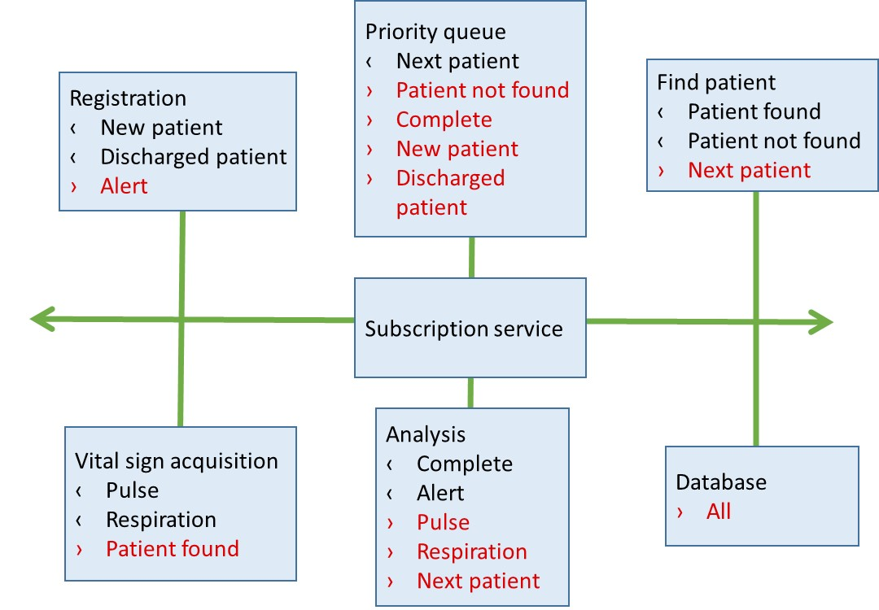
Homework review – Observer design pattern
Similar (but different) to Publish/Subscribe design pattern
subject
subject
subject
observer
observer
observer
observer
Observer– Typically:
Synchronous
Individual components do know about each other
Can be set up statically or dynamically
Pub/Sub – Typically:
Asynchronous
Individual components don’t have to know about each other
Works well across platforms

Slide 9
Homework review – Builder and Factory design patterns
Builder:
Builds up desired object over time
Factory:
Returns object with specified properties immediately
carBuilder.makeEngine(“3.5 liter”)
carBuilder.makeDriveTrain(“4WD”)
carBuilder.makeColor(“Red”)
…
myCar = carBuilder.build()
Apple grannySmith = FruitFactory(“green”, “Granny Smith”)
Apple empire = FruitFactory(“red”, “Empire”)
Orange clementine = FruitFactory(“orange”, “Clementine”)

Slide 10
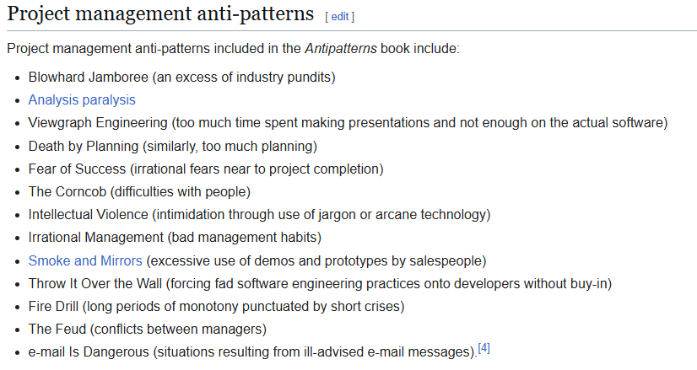
Homework review – Anti-patterns
Commonly used techniques that may have more negative consequences than apparent benefits:
Singleton – a design pattern to guarantee there is only one object instantiation of a specific class. It is listed as a design pattern, but also considered (by some) an anti-pattern
Blob – a single class that has grown to the point where it is too many lines of code, has too many responsibilities, and is hard to maintain
https://en.wikipedia.org/wiki/Anti-pattern

Slide 11
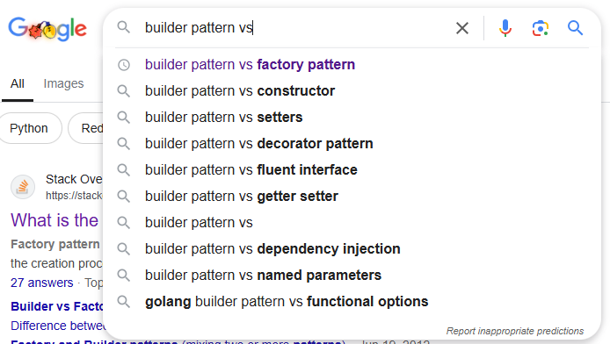
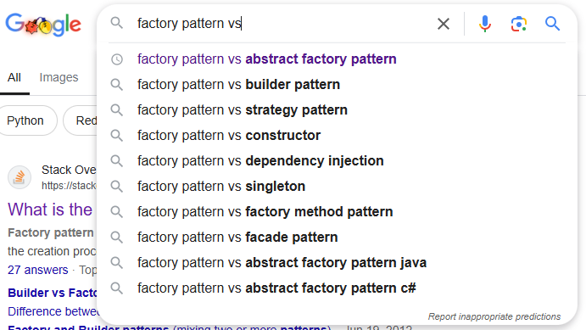
Design Patterns summary
Many more design patterns exist than we covered
There exist programming languages where many (most) of the design patterns are built into the language
All design patterns can be “implemented” using the basic concepts of object-oriented programming
However, there is no “one” implementation as design patterns are (best practice) approaches more than implementations
Use of design patterns may seem overkill for many small, finely focused programming assignments, but can pay off in the long run for larger programs built with future growth and big teams in mind

Slide 12
Considerations
Pros
Can speed up the development process
Proven development paradigms
Tested approaches
Common language among those familiar with patterns
Time invested up front can pay back in the long run
Heavily documented
Can simplify coding
Cons
Frequent use of a design pattern in a specific language may just be an indication that something is missing in that language
Use of existing components or libraries may be a faster, more reliable way to go
The levels of indirection that many design patterns use can lead to inefficient code
Recommendations
Learn about what patterns exist and what problems they can help with
Revisit them as you finish the design of a project
Play around with small examples before starting on a big example/project
Make liberal use of a search engine when encountering a problem

Slide 13
Design Exercise (continued)

Slide 14
Practice design
Each team choose one project idea from the following list. Over the next few ambiguous, you will have the opportunity to further develop the project and receive feedback:
Practice for what we have learned this semester
Practice for the final which will include a design question
Midterm focused on the design process
Final will focus more on the design itself (by employing the design process!)
Practice for potentially taking the Capstone course (all but one idea below are from actual Capstone projects)
Choices are left somewhat ambiguous, so you have the flexibility to further define it like you want
Faster URL Parser
Pass the picture – n people start drawing a picture n their drawing tool, and after x minutes the pictures “rotate” to the next person. This goes on for n times.
Graphical rendering of algorithms for teaching purposes
What should I wear to a specified event
Use eye tracking on phone to move cursor on laptop
Multi-player distributed monopoly
Stock market trading simulator
Let’s meet – like a dating site, but for planning group outings
Help me budget and buy
Super easy to use tablet for nursing home residents
Job search and posting
Escape room game
First task: Give an elevator pitch for your project idea. (60 second talk)

Slide 15
Design Practice
Steps
Elevator pitch
Formal Proposal
Technical Design
Architecture
Components
Communication
DB schema
Run-time representation
Program flow
Algorithm descriptions
Testing Design
Development
Final Testing
With your team:
Decide on best methods of clarifying your technical design
Specify the high-level content that would go into each method, e.g.:
Architecture: Systems, main components, and topology
Component diagram: main components and their interfaces
You do not have to actually create the designs
Take 15 minutes
Present to class
But first some examples.

Slide 16
Build for speed
Faster URL parser:
https://bookshelf.vitalsource.com/reader/books/9781260423297/epubcfi/6/30[%3Bvnd.vst.idref%3Dchapter06]!/4/222/3:197[add%2Citi]
Architecture:
Single module running on as part of the server software
Called by server code with (remaining) URL string
Return to server with parsed URL string in specified format
For testing purposes, I/O to files and/or DB and timing capability
Comprehensive test suite
Language choice: C/C++
Algorithm descriptions
Algorithm / data structure combination to maximize speed of parsing
Agile

Slide 17
Algorithms and Library/pattern matching
Tool kit to create graphical rendering of algorithms for teaching purposes:
Architecture:
Mobile app (or Web app?): Client app to run standalone except for access to server-side DB for design repository
MVC:
GUI – toolkit view and build screen (algorithm specification), output rendering
Representations – algorithm, values to trace
Engine – simulate running algorithm, capturing specified output, converting to external representation (JSON)
Prototype

Slide 18
Security, adaptive recovery, reasoning
What should I wear to a specific event
Architecture: MVC
Dynamic web app:
Client: Basic GUI for simple input / output
App Server: Onboarding, secure login, matching algorithms, connectivity to APIs, output generation
Services servers: APIs
Database: Client info, event info, API sources / access procedures
Algorithms:
Screen scrapers
Inference engine
Prototype → Agile

Slide 19
Speed, accuracy
Use of eye tracking
Architecture:
Pipeline
Capability to be used as a resource to an app
API
Observer design pattern?
Algorithms:
Tuning of sensitivity versus specificity
Real-time response
Prototype

Slide 20
Design Practice
Steps
Elevator pitch
Formal Proposal
Technical Design
Architecture
Components
Communication
DB schema
Run-time representation
Program flow
Algorithm descriptions
Testing Design
Development
Final Testing
With your team:
Decide on best methods of clarifying your technical design
Specify the high-level content that would go into each method, e.g.:
Architecture: Systems, main components, and topology
Component diagram: main components and their interfaces
You do not have to actually create the designs
Take 15 minutes
Present to class
Development: which model?

Slide 21
Software Maintenance

Slide 22
Motivation
Analysis of overall software development costs:
3% analysis
3% specification
5% design,
7% coding!
8% module testing
7% integration testing
67% maintenance
Fundamentals of Software Engineering, 2nd edition
Carlo Ghezzi, Mehdi Jazayeri, Dino Mandrioli
Prentice Hall 2003
~ https://www.researchgate.net/publication/220689590_Fundamentals_of_software_engineering_2_ed

Slide 23
Software Maintenance
Modification of a SW product post delivery to correct faults, improve performance, and keep up with changed environment
80% of SW maintenance is spent on non-corrective actions
20% is spent on bug-fixes
A plan for software maintenance should be created before the product is released. It includes both business and software engineering decisions. See https://images.techstreet.com/direct/SWM_samples.pdf for a template of a plan. The plan should include:
Who (or what team) will perform the software maintenance
How involved will the original development team be involved
How will change requests be created
Help desk
Email
User forum
How will change requests be tracked
How long will the product be supported
After a new release will updates to previous versions be handled
Examples:
Y2K
COVID

Slide 24
Software Maintenance
Some things to consider:
App-based versus web-based
Non-bugs that could force software changes
OS changes
DBMS changes
Browser changes
Changed standards
Server changes
Another study, another view - what SW maintenance includes:
Adaptive – Environmental changes
Perfection – Customer requests
Corrective – Bug fixes
Preventative – Increasing software maintainability
Interesting statistics:
The cost to maintain one line of source code may be 20 to 40 times the cost of initial development of that line
The Linux Kernel has about 10,000,000 lines of code, spread over 40,000 unique files…
Facebook over 60 million lines of codes
Windows 7 over 40 million
Android 12 million
F35 Lockheed fighter jet 25 million lines.
75%
21%
4%

Slide 25
Software Maintenance
Six software maintenance processes:
Implementation
Maintenance plan
Prepare for handling problems identified during development
Follow up on configuration management
Problem and modification phase
Receive modification request
Validate modification request
Prioritize outstanding requests
Implement modification
Validating and testing phase
Platform migration
Retirement of software
From: https://en.wikipedia.org/wiki/Software_maintenance#Software_maintenance_processes

Slide 26
Software Maintenance – GameCo example
Version control (External view)
R & D
Chess 0.0
Single System
2-player
PC/Windows only
Chess V1.0
AI
Chess 2.0
Remote play
Ranking
Stats
Chess V3.0
…
Backgammon 0.0
Maintenance
Chess V1.0 Release
UI improvements
Fix known bugs
Fix reported bugs
Chess V1.1 Release (planned)
Fix critical bug
Chess V1.1.1 Release (unplanned)
Port to Mac
Port to iPhone
Port to Android
Chess V1.0 {M, i, A} Release
Incorporate AI for all platforms
Bug fixes
Chess V2.0 {P, M, i, A} Release
Remote play, AI, et al.
Chess 3.0 {P, M, i, A} Release
???

Slide 27
Software Maintenance – GameCo example
Version control (Internal view)
Origin
Origin
R&D
V1
Server V1.0
V1.1
V1.1.1P
V1.0M
V1.0i
V1.0A
Origin
V2.0
V2.0
V2.0
V2.0
V3.0
V3.0
V3.0
V3.0
Chrome V1.0
IE
V1.0
Safari
V1.0
Opera
V1.0

Slide 28
Forward engineering methods
You can struggle through modification after modification, fighting the ad hoc design and tangled source code to implement the necessary changes.
You can attempt to understand the broader inner workings of the pro- gram in an effort to make modifications more effectively.
You can redesign, recode, and test those portions of the software that require modification, applying a software engineering approach to all revised segments.
You can completely redesign, recode, and test the program, using reengineering tools to assist in understanding the current design.

Slide 29
Code refactoring is the:
Process of restructuring existing computer code—changing the factoring—without changing its external behavior.
Refactoring is intended to improve nonfunctional attributes of the software.
Advantages include improved code readability and reduced complexity;
Can improve source-code maintainability and create a more expressive internal architecture or object model to improve extensibility
https://en.wikipedia.org/wiki/Code_refactoring

Slide 30
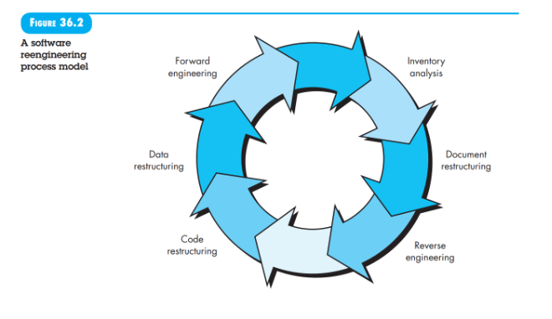
Software reengineering
Inventory analysis – Collect and sort out information according to business criticality, longevity, current maintainability and supportability, and other locally important criteria
Document restructuring - Weak documentation is the trademark of many legacy systems.
Reverse engineering - Create a representation of the program at a higher level of abstraction than source code.
Code restructuring - To accomplish this activity, the source code is analyzed. Poorly programmed constructs are noted and code is then restructured or even rewritten in a more modern programming language.
Data restructuring – For many applications, information architecture has more to do with the long-term viability of a program than the source code itself.
Forward engineering - In most cases, reengineered software re-creates the function of the existing system and also adds new functions and/or improves overall performance.

Slide 31
Security

Slide 32
Security
In its required form our project requires little in the way of security:
This is rare
In many applications and in most browser/web apps security is a major part of a design:
Secure login
Encryption of sensitive information
A server has its own security concerns:
Masquerading
Denial of service
Potential problem areas:
Third-party JavaScript Vendors - Modern web apps load an average of 20+ third-party scripts
Relance on Form Data - Form data is typically exposed to over 15 different 3rd party domains
Cross-site scripting (XSS: Injecting malicious code into website content) – 53% of web applications are affected by this vulnerability
Magecart Attack – payment skimming
Broken Link Hijacking
Memory breaches
Many security failures are due to “humanware”: Weak passwords, writing down passwords, leaving browser windows open on public computers, leaving laptop unattended, visiting “questionable” sites, not using virus detection, responding to Phishing emails, …
https://www.feroot.com/education-center/what-is-client-side-security/
https://www.tropicapp.io/blog/security-tech-stack

Slide 33
Security
Make use of proven libraries/tools:
Okta/Auth0 – For authentication and authorization
Firebase – For authentication
NextAuth.js – For authentication
Duo Security – MFA (Multi Factor Identification)
Azure Active Directory – Cloud-based identity and access management
Authy – two-factor authentication
Amazon Cognito – Secure user authentication service
Inspector, PageGuard
Employ best practices when building web site:
Password hashing
Prevent XSS (Cross Site Scripting)
Use secure cookies
Incorporate rate limiting
Documentation on programming your own security solutions exist, but using existing/proven solutions is probably a better way to go
https://www.feroot.com/education-center/what-is-client-side-security/
https://www.tropicapp.io/blog/security-tech-stack

Slide 34
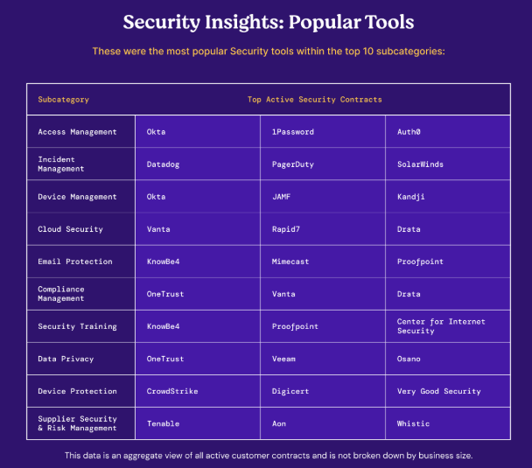

Slide 35
Design Exercise (continued)

Slide 36
Design Practice
Steps
Elevator pitch
Formal Proposal
Technical Design
Architecture
Components
Communication
DB schema
Run-time representation
Program flow
Algorithm descriptions
Testing Design
Development
Final Testing
With your team:
Decide on best methods testing your application/program. What (if any):
Functions require extensive unit testing
Components need integration testing
System tests should be run
Acceptance tests should be run
Take 10 minutes and then present to class
But first some examples.

Slide 37
Faster, while still accurate
Faster URL parser:
https://bookshelf.vitalsource.com/reader/books/9781260423297/epubcfi/6/30[%3Bvnd.vst.idref%3Dchapter06]!/4/222/3:197[add%2Citi]
Unit tests:
Parser works with extensive (industry supplied) test suite
Output is in required format
Component test
Parser module integrates with server code
Timed test with extensive (industry supplied) test suite
System test
Test suite run from external client
Acceptance test
Supply code and test suite to 3rd parties for independent testing (e.g. W3C)

Slide 38
Will users buy it?
Tool kit to create graphical rendering of algorithms for teaching purposes:
Unit, component, and system testing: as expected
Acceptance testing:
Can users create desired renderings
Can users create desired renderings faster than previous methods
Will users buy it

Slide 39
Homework

Slide 40
Team presentation next week
Present to the whole class, not just me!
<=20 minutes
Involve whole team in presentation
Start by showing your understanding of the deliverable, e.g.
Storyboard(s)
Use case diagram(s)
Present a demonstration (show by running 2 puzzles simultaneously)
What is working
What is still a work in progress
What development process did you use
High-level architecture
Each team member does a high-level walk through of their efforts (focus on diagrams, not code)
Main data structures
Database schema
Primary code flow and/or algorithm description
Testing
Show plan
Show/demo testing results
Open discussion
What went well
What went wrong(ish)? In retrospect how could problem have been avoided?

Slide 41
Final in two weeks
Test will be similar to mid-term in format
Short answer closed book questions
Will only cover second half of the semester
Design problem – open book
Less on design process (like the midterm)
More on actual design decision (like our practice sessions the last few weeks)

Slide 42
Closing comments
A few words about the project
Project meant to be a learning experience
I anticipated (even planned for) many of the issues you faced
Project meant to introduce you to many of the issues you will face in a (future) professional career
My hope is that everyone came away from this project with ideas on how they/the team could have done things better
Experiencing issues is a far better learning tool than just hearing about them
Class was taught in a primarily breadth first manner
More time was spent on topics I thought you would not cover in other classes (e.g. Storyboards, UML, the overall design process)
Less time was spent on topics that other courses cover in detail (e.g. security, design patterns)
Less time was spent on topics tightly coupled with tools whose use would be specific to a given workplace (e.g. project planning, deployment/maintenance)

Slide 43
Project Time

